Slide 1

Micro Electronics
ITP-2018-MLB-G1-15

Slide 2
Introduction
Client
Our client’s name is Mr. Edirisoriya.
He is owner of the Micro Electronics.
The date of the commencement business was 01st of September 2017.
They are selling and manufacturing electronics parts.

Slide 3
Introduction
Problems, our client had.
They currently used a manual file base system.
This current process required many books to record data.
And manually makes reports, time consuming, complicated (search, edit, add, update etc.).
Those are the main problem our client had.

Slide 4
Introduction
Solution
Develop a Desktop Application keep data.
Add functions to store data in efficient.
Organized system with reporting capabilities.
computerizing employee details and no more manual calculations in their business. (example :-salary, profit, bill etc.)

Slide 5
Introduction
Benefits
Client will be able to store data in efficient.
He will be able to reduce employee works.
It will be easier to generate reports automatically.
System will be restricted unauthorized access and concurrent access.
The system is reliable, less time consuming, easy to use, avoid data manipulation, inconsistency and redundancy.

Slide 6
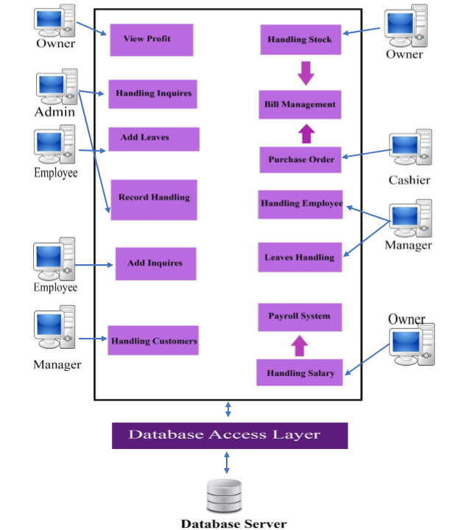
System Overview

Slide 7
Inventory Management
When our client buy products, they will added it stock management.
They will be able to update and delete stocks details.
Also they will be able to add a product to system and update, delete product details.
If some stock is going to run out, our client will be able to see it in exceed report.
Also client can view wholesale prices.
When customer purchases an order cashier able to calculate bill and add payments, it will deducted from available products.
Also they will be able to view reports.

Slide 8
Payroll System
In this business, employees leaves will recorded by the system.
Client will be able to calculate salary using leaves data and employee details.
Also client will be able to update and delete employee salaries.
Client will be able to calculating salary with OT rate and hours.
This function includes the generating the salary report also.

Slide 9
User Management
This function is supported to keep record of users in their business.
This users are employees and customers.
When a new employee join the company, client able to add their details in to the system.
Client will be able to handling employees and promote their position.
And also client will be able to view customer details under their purchases.
Also this function includes the generating the customer and employee report.

Slide 10
Admin Management
In this function all the employees will be able to add inquires.
This inquires will handled by the admin.
Only admin can update and remove payments.
All the profit from the shop will be calculated by the admin.
Admin also able to add, update, remove all the functions inside the system.

Slide 11
Tools and Technologies.
For that the technologies we decided to use are Java (JFrame, Application Window), Java Swing Designer.
We are using to build our database with MySQL (To connect Windows Builder Pages with the Database) and WAMP Server along with the Tomcat server.

Slide 12
Work break down structure.
IT Number | Name | Function
IT16178700 | D.I.K. Rajapakshe | • Handling Product • View wholesale price • Handling Stock • View Stock Report • View Exceed Stock Report • Check available items • Purchase Order • Handling Bills • Calculate Bill
IT17018760 | M.P.P. Shamil | • Handling Leaves • Add bonus • Handling salaries • Generating salary report • Print salary

